Slide 1
Platformer Adventures! Shira Balali Trailer: https://www.youtube.com/watch?v=3_VCSHAb67o

Slide 2
Missing features
- LOD Assets – Not relevant to 2D - Stealth Recast - Didn't understand feature / Not relevant to game theme
Known bugs
- Skeleton AI - In some rare cases it doesn't chase the player perfectly.

Slide 3
Introduction
Platformer Adventures is an engaging 2D platform game that offers players a dynamic and challenging experience.
The game features six unique levels, each with its own distinct theme and difficulty, as well as a variety of characters, enemies, and obstacles. Players will need to navigate through these levels, utilizing different characters and controlling the game solely by using the space bar on the keyboard, to overcome enemies and environmental hazards.

Slide 4
Overview
"Platformer Adventures" immerses players in a captivating 2D world where they control six distinct characters: the sturdy Bear, graceful Giraffe, skilled Indian, rugged Lumberjack, agile Robber, and loyal Doggy.
Across six levels of varying difficulty, each character brings their abilities to the forefront.
Throughout these diverse levels, players must navigate past formidable enemies like the Skeleton and elusive Vampire, while also tackling hazardous elements including the Menacing Stone Ball, Intricate Long Metal Spike, Versatile Rope, Rotating Saw and Block Crusher.
The game promises an exhilarating journey filled with dynamic platforming mechanics and strategic decision-making.

Slide 5

Main Menu Scene

Slide 6
Main Menu Scene
- Main menu - Main menu scene. - Scene parameters – background music. - Game triggers - buttons entrance/exit.

Slide 7
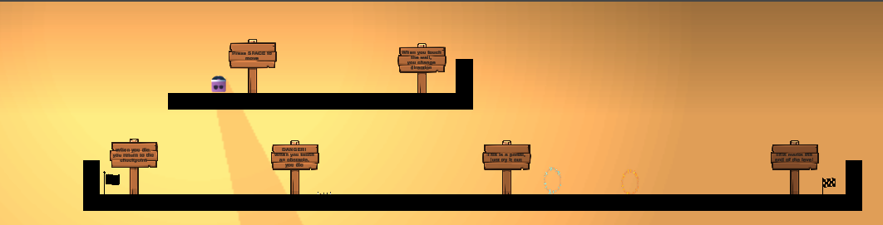
Guide Scene
The cool boy
The finish point
The checkpoint
The portal
The Intricate Long Metal Spike

Slide 8
Guide Scene
-In-game tutorial - Game guide scene. - Scene parameters – background music. - Game triggers - Collision detection and teleport. - Collision Detection – Obstacles. - Terrain - Game tiles. - Penalty - Dying penalty. - Scene Parameters - Background music. - Original Assets - Metal spike. - Original Animator – Portal. - Dynamic Camera - Moving main camera.

Slide 9
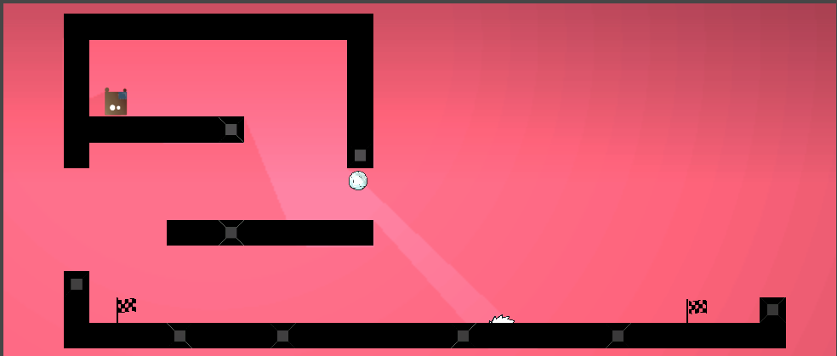
Level 1
The sturdy bear
The menacing stone ball
The finish point
The rotating saw
The finish point

Slide 10
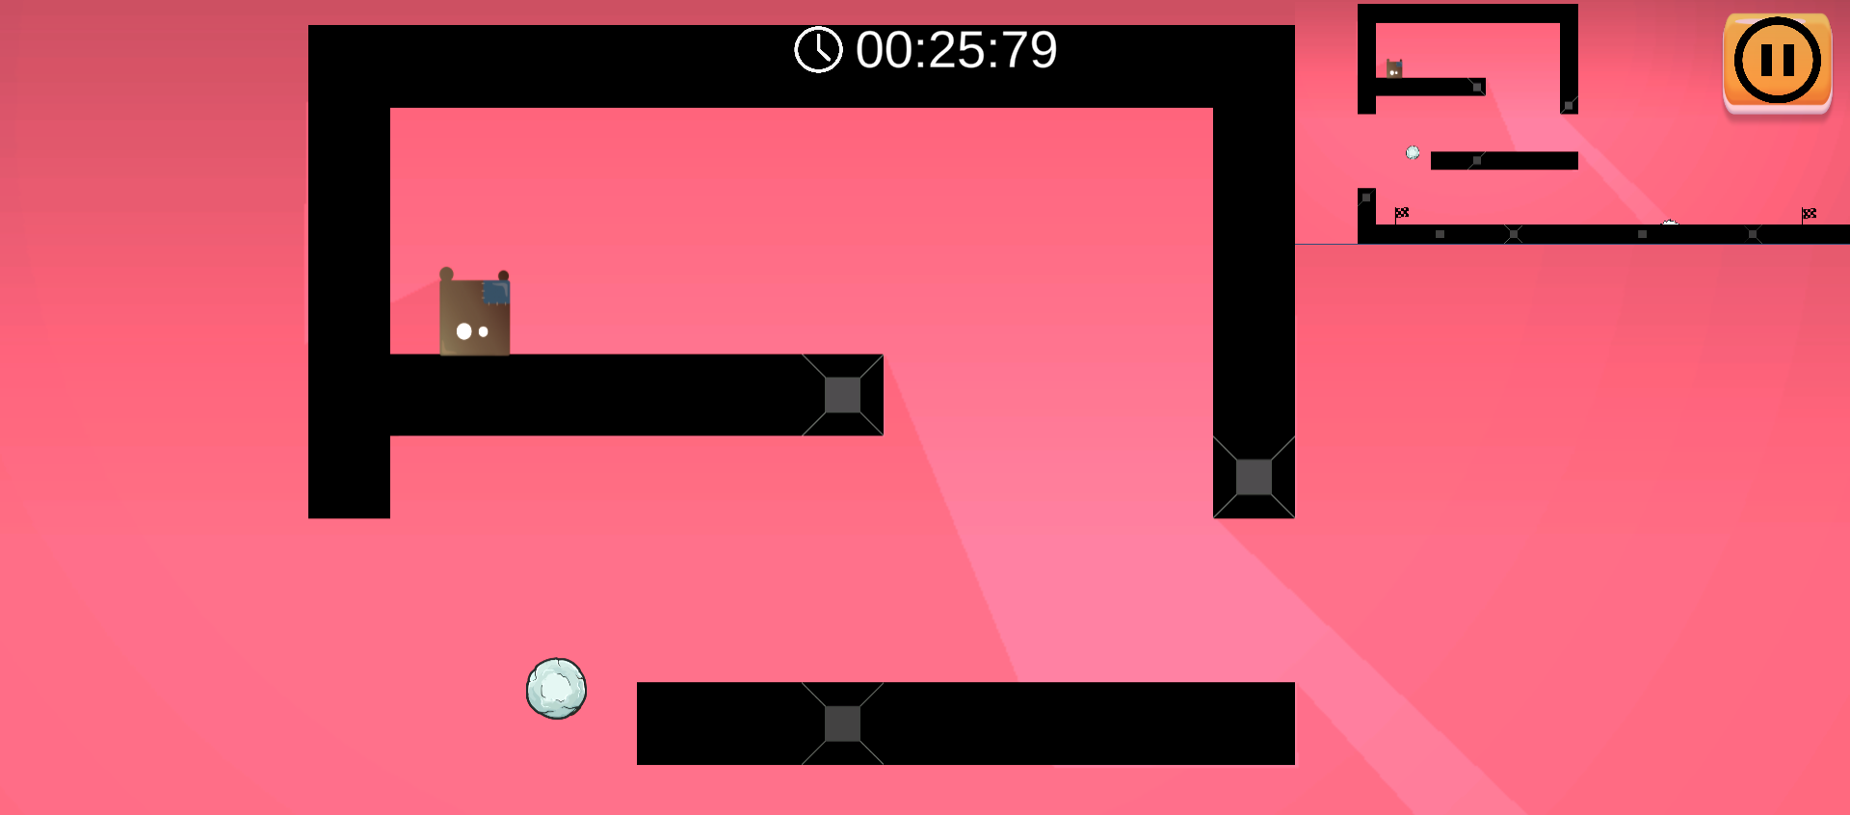
Level 1
The mini map

Slide 11
Level 1
- Physical element shooting – Menacing Stone Ball. - Mini map. - Dynamic camera – Moving main camera. - Scoring/Penalty – Game timer and dying penalty. - Scene parameters – Game score and background music. - Game triggers - Collision detection and finish point. - Collision detection - Obstacles using Triggers and Labels. - Terrain – Game tiles.

Slide 12
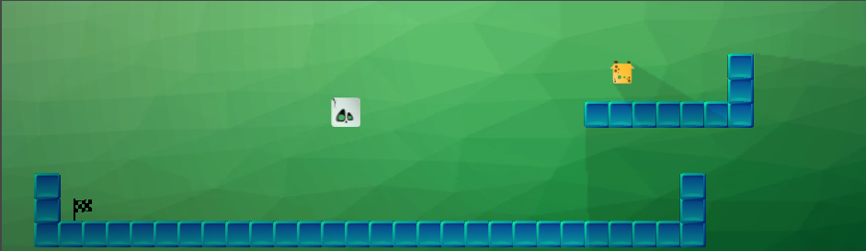
Level 2
The graceful giraffe
The enemy:
The skeleton
The finish point

Slide 13
Level 2
- Dynamic camera – Moving main camera. - Scoring/Penalty – Game timer and dying penalty. - Scene parameters – Game score and background music. - Game triggers - Collision detection and finish point. - Collision detection - Obstacles using Triggers and Labels. - Terrain – Game tiles. - ml-agents - Skeleton Enemy. - AI Steering - Skeleton Enemy.

Slide 14
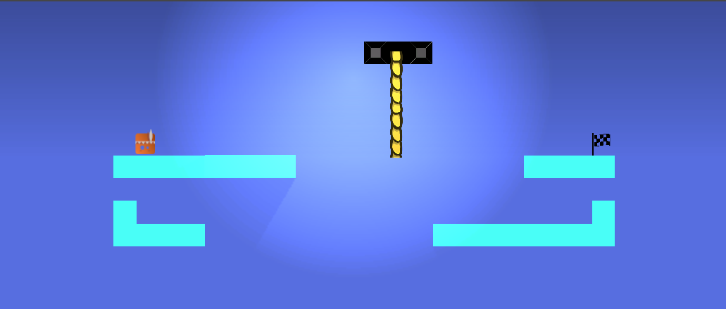
Level 3
The Indian
The Versatile Rope
The finish point

Slide 15
Level 3
- Scoring/Penalty – Game timer and dying penalty. - Scene parameters – Game score and background music. - Game triggers - Collision detection, moving platform and finish point. - Collision detection – Obstacles and moving platform using Triggers and Labels. - Terrain – Game tiles. - Physical Hinges - Rope. - Original Assets - Rope.

Slide 16
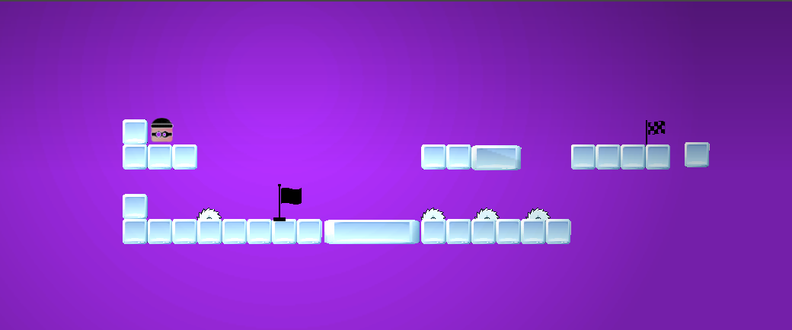
Level 4
The agile Robber
The finish point
The rotating saw
The checkpoint

Slide 17
Level 4
- Scoring/Penalty – Game timer and dying penalty. - Scene parameters – Game score and background music. - Game triggers - Collision detection and finish point. - Collision detection - Obstacles using Triggers and Labels. - Terrain – Game tiles. - Original Animator - Rotating Saw.

Slide 18
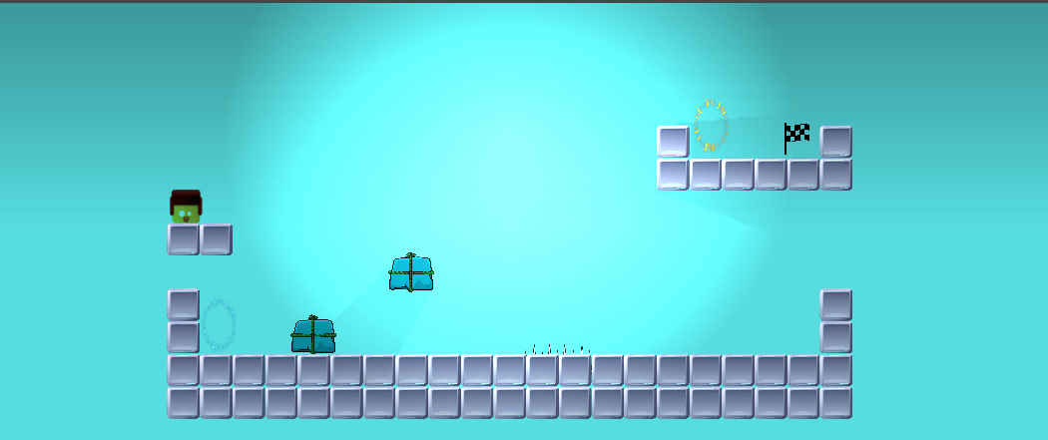
Level 5
The portal
The finish point
The rugged lumberjack
The Block Crusher
The Intricate Long Metal Spike

Slide 19
Level 5
- Scoring/Penalty – Game timer and dying penalty. - Scene parameters – Game score and background music. - Game triggers - Collision detection and finish point. - Collision detection - Obstacles using Triggers and Labels. - Terrain – Game tiles. - Original Animator – Portal. - Original Assets - Metal spike and block crusher.

Slide 20
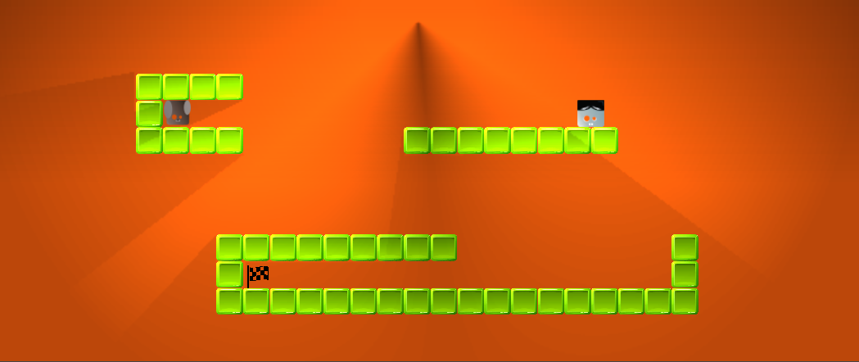
Level 6
The enemy:
The elusive vampire
The loyal Doggy
The finish point

Slide 21
Level 6
- Scoring/Penalty – Game timer and dying penalty. - Scene parameters – Game score and background music. - Game triggers - Collision detection and finish point. - Collision detection - Obstacles using Triggers and Labels. - Terrain – Game tiles. - Patrol - Zombie enemy. - Pathfinding - Zombie Enemy.

Slide 22
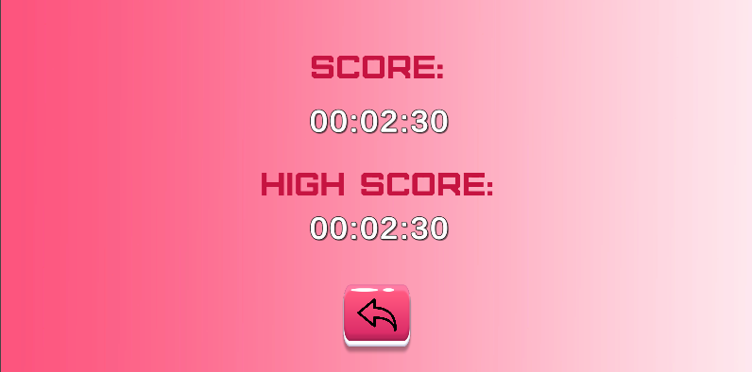
Finish Game Scene

Slide 23
Finish Game Scene
- Score menu - Finish game scene - Scene parameters – Game score and background music. - Game triggers - button return to menu.

Slide 24
Thank you!

